Slide 1
Composition-based Multi-Relational
Graph Convolutional Networks
Shikhar Vashishth, Soumya Sanyal, Vikram Nitin, Partha Talukdar
Presented by - Sripath Mishra, Te-Lin Wu
01/19, CS249, Winter 2021

Slide 2
Outline
Introduction
Related Works
Background
Main Method: CompGCN
Experiments
Conclusions & Summaries
Notes:
Briefly talk about how this talk will be structured...

Slide 3
Outline
Introduction
Related Works
Background
Main Method: CompGCN
Experiments
Conclusions & Summaries

Slide 4
Motivation
Graphs are very expressive data structures
Graph Convolutional Neural Network (GCN) is proven powerful
Most GCN handles undirected graphs

Slide 5
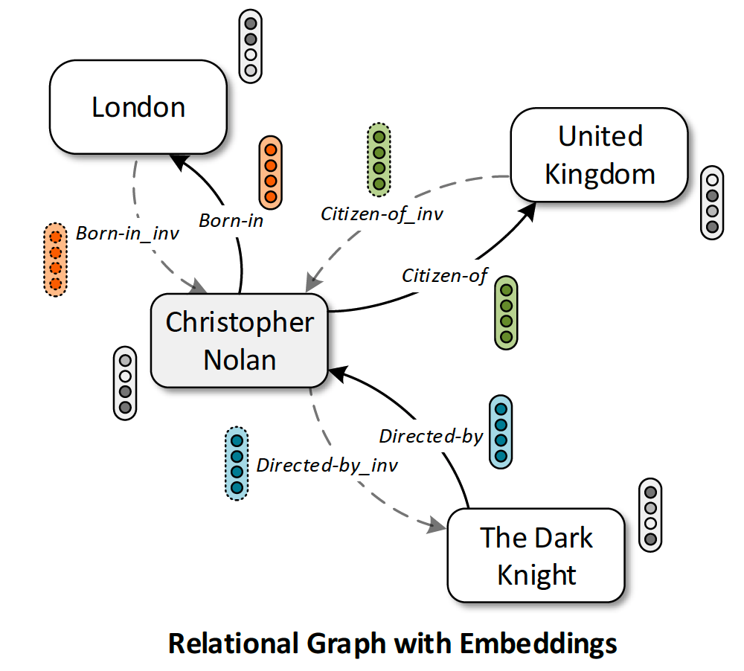
Motivation
Graphs are very expressive data structures
Graph Convolutional Neural Network (GCN) is proven powerful
Most GCN handles undirected graphs
Multi-Relational Graphs
Graphs with relations
Eg. Knowledge Graphs

Slide 6
Motivation
Graphs are very expressive data structures
Graph Convolutional Neural Network (GCN) is proven powerful
Most GCN handles undirected graphs
Multi-Relational Graphs
Graphs with relations
Eg. Knowledge Graphs
Entity
Relation

Slide 7
Motivation
Cons of prior works on multi-relational graphs
Over-parameterization
Only handles node representations
Can not perform link predictions
Existing techniques on knowledge graph embeddings (KE)
Only does link predictions

Slide 8
Motivation
Cons of prior works on multi-relational graphs
Over-parameterization
Only handles node representations
Can not perform link predictions
Existing techniques on knowledge graph embeddings (KE)
Only does link predictions
Solution:
Combine both: GCN + KE

Slide 9
CompGCN
Compositional-based Graph Convolutional Network
Notes:
Proposed work.

Slide 10
Outline
Introduction
Related Works
Background
Main Method: CompGCN
Experiments
Conclusions & Summaries

Slide 11
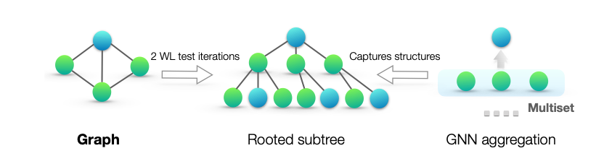
Related Works
Graph Convolutional Networks
Middle panel: rooted subtree structures (at the blue node) that the WL test uses to distinguish different graphs. Right panel: if a GNN’s aggregation function captures the full multiset of node neighbors, the GNN can capture the rooted subtrees in a recursive manner and be as powerful as the WL test.
[Xu et al., 2019]
Notes:
Knowledge Graph Embedding

Slide 12
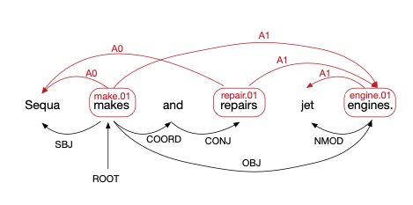
Related Works
GCNs for Multi-Relational Graph
An example sentence annotated with semantic (top) and syntactic dependencies (bottom).
[Marcheggiani & Titov (2017)]

Slide 13
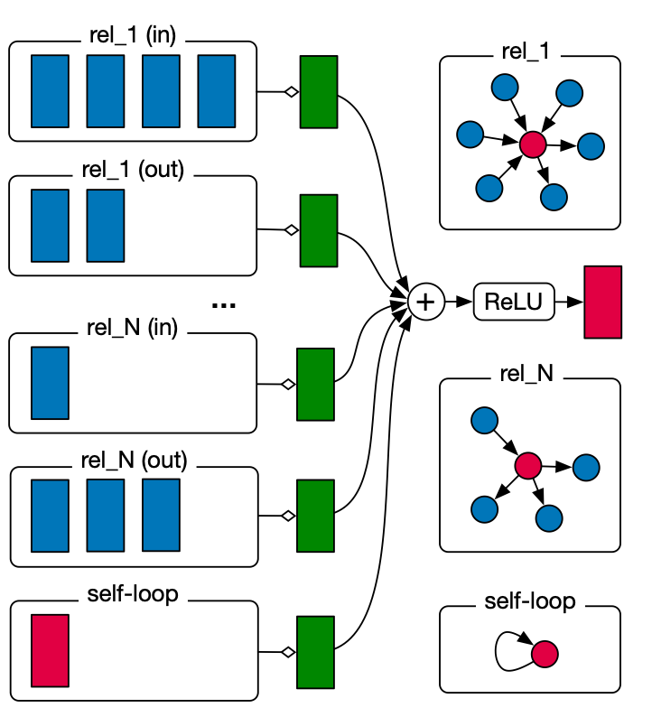
Related Works
GCNs for Multi-Relational Graphs
Update in the R-GCN model.
Activations (d-dimensional vectors) from neighboring nodes (dark blue) are gathered and then transformed for each relation type individually (for both in- and outgoing edges). The resulting representation (green) is accumulated in a (normalized) sum and passed through an activation function (such as the ReLU).
[Schlichtkrull et al., 2017]

Slide 14
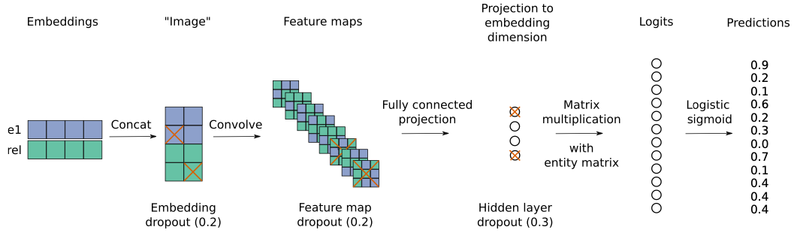
Related Works
Knowledge Graph Embedding
In the ConvE model, the entity and relation embeddings are first reshaped and concatenated (steps 1, 2); the resulting matrix is then used as input to a convolutional layer (step 3); the resulting feature map tensor is vectorised and projected into a k-dimensional space (step 4) and matched with all candidate object embeddings (step 5).
[Dettmers et al., 2018]
Notes:
Knowledge Graph Embedding

Slide 15
Outline
Introduction
Related Works
Background
Main Method: CompGCN
Experiments
Conclusions & Summaries

Slide 16
GCN on Undirected Graphs
Undirected Graph: G = (V, E, X)
V: set of vertices
E: set of edges
X ∈ R^{|v|*d0} : d₀-dimensional input features of each node
The node representation for a single GCN layer: H = f(ẬXW)
Ậ = D^{-1/2}(A+I)D^{+1/2}
D_{ii} = ∑_{j}(A+I)_{ij} ,
W ∈ R^{d0xd1}
f: some activation function

Slide 17
GCN on Multi-Relational Graphs
Multi-Relational Graph: G = (V, R, E, X)
R: set of relations
(u, v, r): relation r ∈ R from node u to v.
Inverse edge: (v, u, r⁻¹)
k-th layer representations of a relational graph: H^{k+1}=f(ẬH^{k}W^{k}_{r})
W^{k}_{r} : relation-specific parameters

Slide 18
Outline
Introduction
Related Works
Background
Main Method: CompGCN
Experiments
Conclusions & Summaries

Slide 19
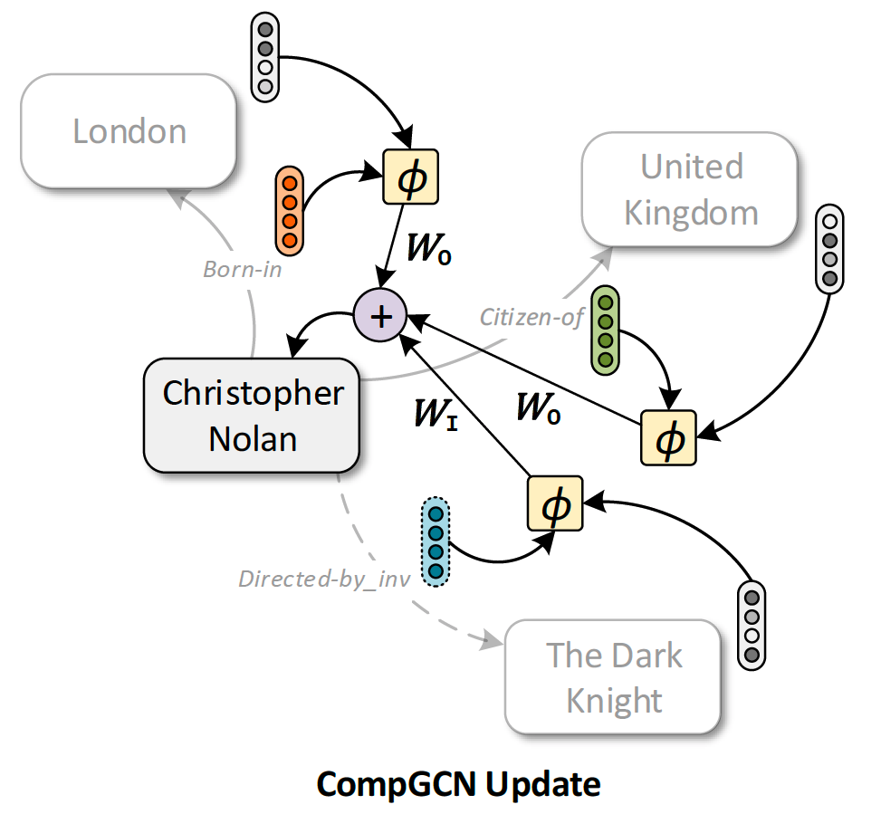

Overview
Notes:
Here we (again) illustrate a kind of knowledge graph with nodes denoting certain entities, and the the edges denote the relations and their types.

Slide 20
Overview
A KG Triplet (E1, R, E2):
Eg. (The Dark Knight, Directed by, Christopher Nolan)
Notes:
Eg. Christopher Nolan is the director of The Dark Knight, so we can have a tuple of (The Dark Knight, Directed By, Christopher Nolan)

Slide 21
Overview
Inverse Relations
Notes:
In this multi-relation graph, we can also have inverse relations, such as directed_by_inv, basically is something like, X directed Y.
There can be some self loops as well, but they are omitted here.

Slide 22
Overview
Notes:
For the update rule in CompGCN, for example if we are updating the node, Christopher Nolan,

Slide 23
Overview
Compositional Operations
Over: (Node, Relations)
Notes:
CompGCN will first perform a compositional operations over the node and the relational embeddings, phi here denotes the composition operation, which we will describe the details later. And then the composed representations will be multiplied by their corresponding learnable parameters, like, the convolve operation in standard GCN. W_I here is dealing with the inverse relations, which obviously they are separately handled.
Relational embedding are being updated as well, details to come later.

Slide 24

Basic Notations
Multi-Relational Graph:

Slide 25
Basic Notations
Multi-Relational Graph:
Entity Node
Relations
Edges (Directed)

Slide 26



Basic Notations
Multi-Relational Graph:
Entity Node
Relations
Edges (Inverse & Self-Loops)
Notes:
T, is denoting self-loops here, and superscript -1 is the inverse.

Slide 27
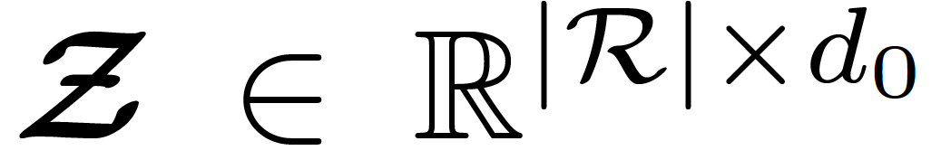
Basic Notations
Multi-Relational Graph:
Node Input Features
Initial Relation Features

Slide 28
Representing Relations as Vectors
Alleviates over-parameterization on relational graphs
Allows utilizing any available relational features as initializations

Slide 29


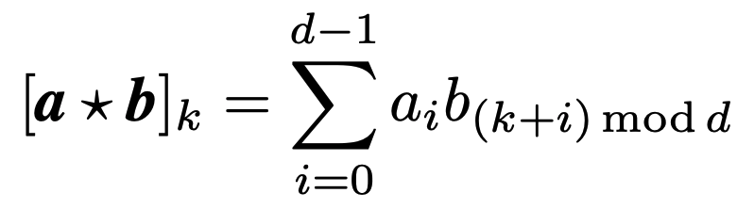
Representing Relations as Vectors
Alleviates over-parameterization on relational graphs
Allows utilizing any available relational features as initializations
Compositional Operations:
Non-Parameterized Operations
Subtraction
Multiplication
Circular-Correlation
Notes:
To incorporate relation embeddings into the GCN formulation, CompGCN leverages the entity-relation composition operations used in Knowledge Graph embedding approaches.
In this paper, we restrict ourselves to non-parameterized operations like subtraction, multiplication, and circular-correlation (Nickel et al., 2016). However, COMPGCN can be extended to parameterized operations like Neural Tensor Networks (NTN)

Slide 30
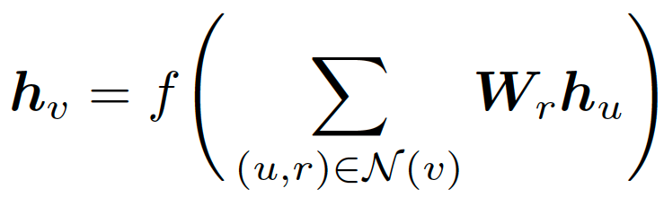
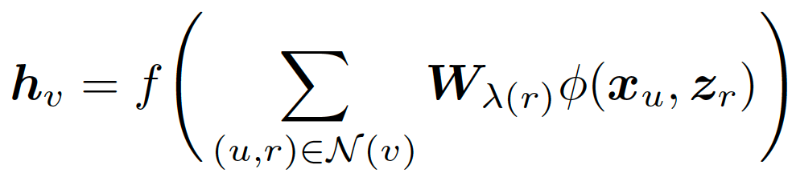
Update Rule
Standard Update Rule:
Notes:
where N(v) is a set of immediate neighbors of v for its outgoing edges.

Slide 31
Update Rule
Standard Update Rule:
Suffers from over-parameterization as each r needs its W!

Slide 32
Update Rule
Standard Update Rule:
Notes:
in COMPGCN we perform composition () of a neighboring node u with respect to its relation r as defined above.

Slide 33

Update Rule
Standard Update Rule:
Number of feature dimensions:
Notes:
This allows our model to be relation aware while being linear in the number of feature dimensions
where xu; zr denotes initial features for node u and relation r respectively, hv denotes the updated representation of node v

Slide 34
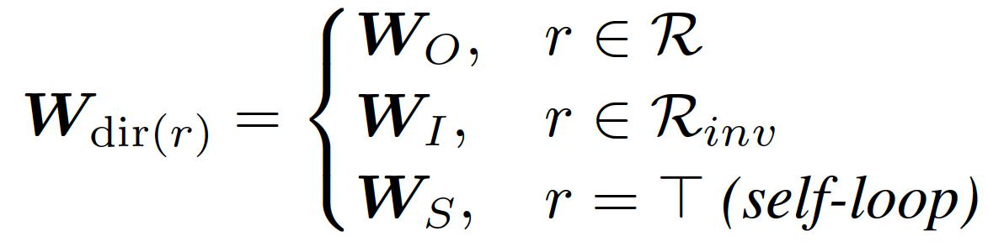

Update Rule
Relation-Specific Weights:
Number of feature dimensions:
Notes:
is a relation-type specific parameter. In COMPGCN, we use direction specific weights, i.e., (r) = dir(r), given as:

Slide 35


Update Rule
Relation-Specific Weights:
Relational Embedding Update:
Notes:
where Wrel 2 Rd1d0 is a learnable transformation matrix which projects all the relations to the same embedding space as nodes and allows them to be utilized in the next COMPGCN layer

Slide 36
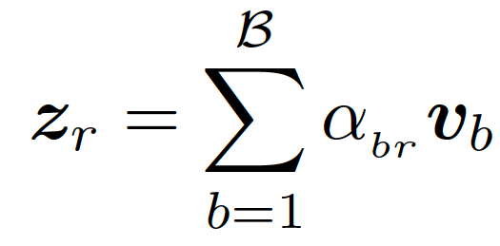

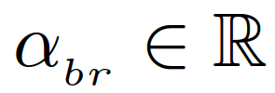
Scaling the Number of Relations
Relational Vectors are:
Linear Combinations of a set of learnable basis vectors
Learnable Scalar Weights:
Notes:
To ensure that COMPGCN scales with the increasing number of relations, we use a variant of the basis formulations
Instead of independently defining an embedding for each relation, they are expressed as a linear combination of a set of basis vectors. Formally, let fv1; v2; :::; vBg be a set of learnable basis vectors. Then, initial relation representation is given as:
Note that this is different from the basis formulation in Schlichtkrull et al. (2017), where a separate set of basis matrices is defined for each GCN layer. In contrast, COMPGCN uses embedding vectors instead of matrices, and defines basis vectors only for the first layer. The later layers share the relations through transformations according to Equation 4. This makes our model more parameter efficient than Relational-GCN.

Slide 37
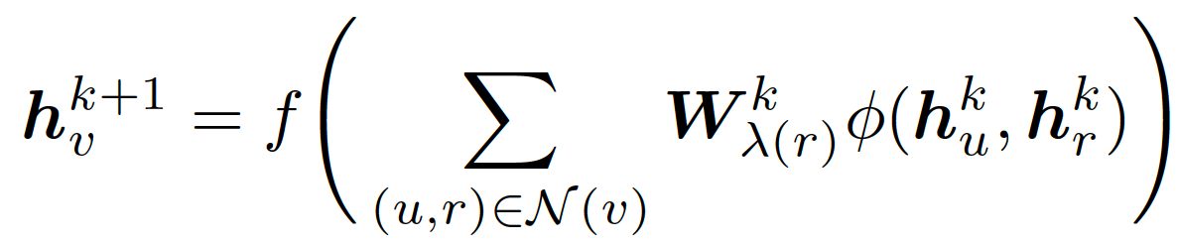
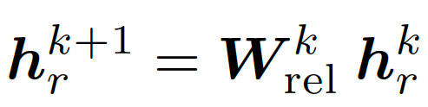
Stacking CompGCN (k-Layers)
Node Embedding Update:
Relational Embedding Update:
Notes:
Here, h0v and h0r are the initial node (xv) and relation (zr) features respectively

Slide 38
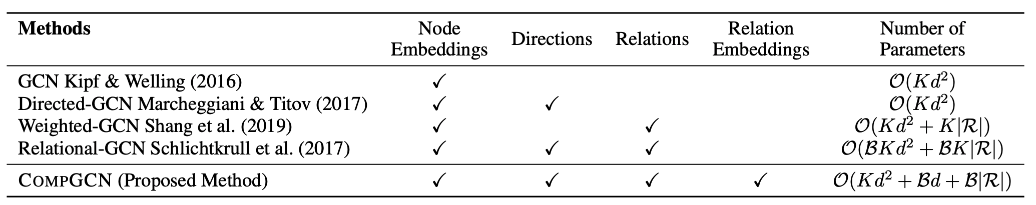
GCN Comparisons
K: Number of GCN Layers
d: Embedding dimension
B: Number of bases
|R|: Total number of relations
Notes:
Overall, COMPGCN is most comprehensive and is more parameter efficient than methods which encode relation and direction information.

Slide 39
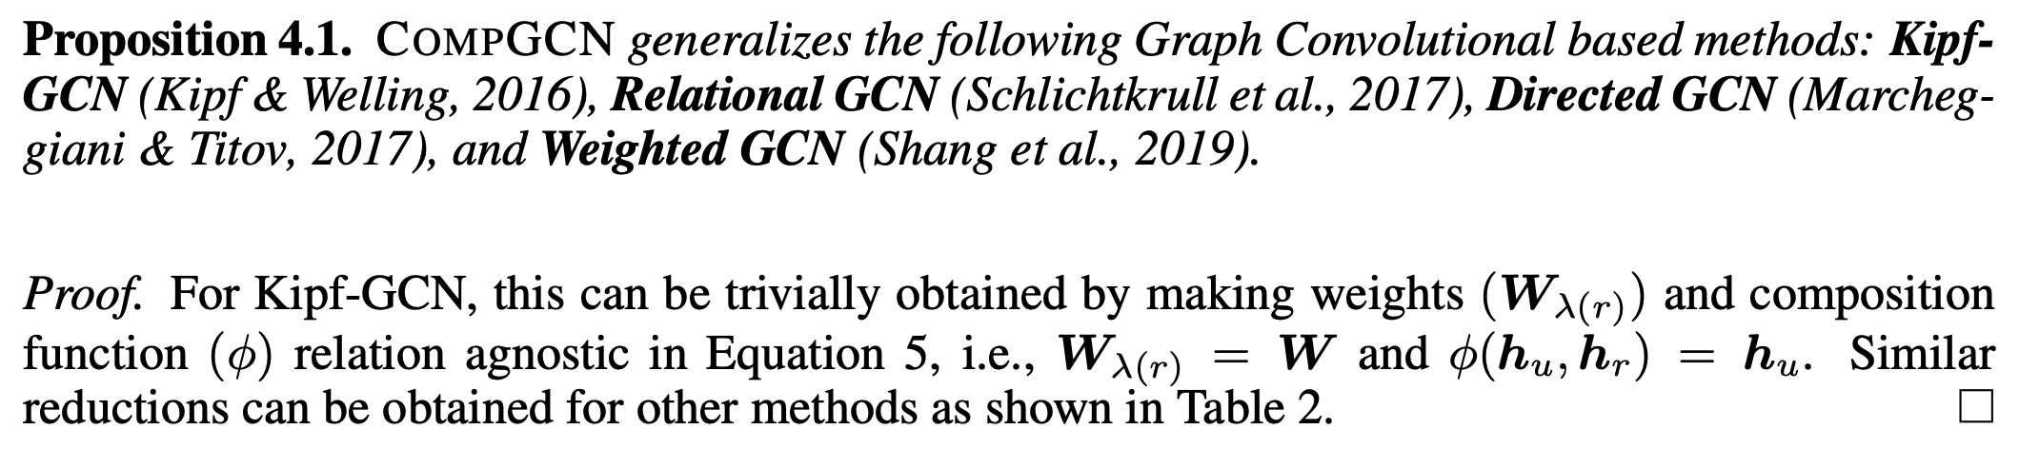
Reduction of CompGCN

Slide 40
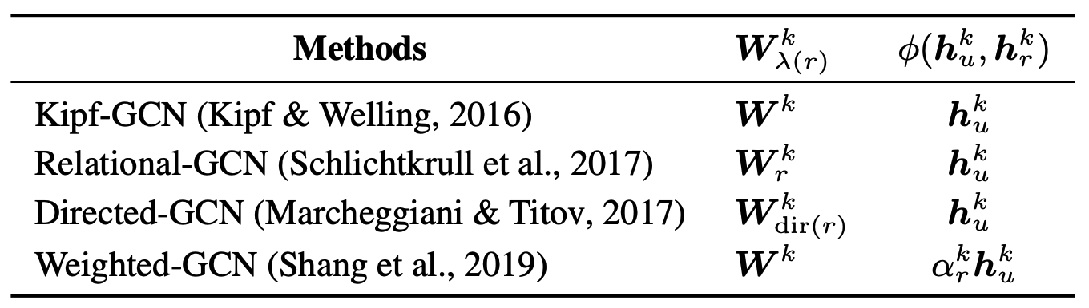
Reduction of CompGCN
Notes:
Reduction of COMPGCN to several existing Graph Convolutional methods. Here, kr is a relation specific scalar,Wkr denotes a separate weight for each relation, andWkdir(r) is as defined in Equation 3. Please refer to Proposition 4.1 for more details.

Slide 41
Outline
Introduction
Related Works
Background
Main Method: CompGCN
Experiments
Conclusions & Summaries

Slide 42
Benchmarking Tasks
Link Predictions
Node Classifications
Graph Classifications

Slide 43
Benchmarking Tasks
Link Predictions
Inferring missing facts based on known facts in KGs
Datasets: FB15k-237 (FreeBase), WN18-RR (WordNet)
Metrics: MRR & MR & Hits@N
Node Classifications
Predicting labels of nodes
Based on node features and connections
Datasets: MUTAG & AM
Graph Classifications
Learns representations of graphs, and predicts the types of graphs
Datasets: MUTAG & PTC

Slide 44
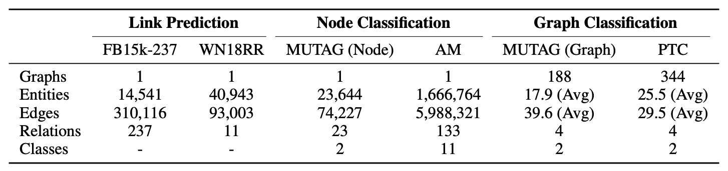
Dataset Statistics
Notes:
The details of the datasets used for node classification, link prediction, and graph classification tasks.
FB15k-237 (Toutanova & Chen, 2015) is a pruned version of FB15k (Bordes et al., 2013) dataset with inverse relations removed to prevent direct inference.
WN18RR (Dettmers et al., 2018), similar to FB15k-237, is a subset from WN18 (Bordes et al., 2013) dataset which is derived from WordNet (Miller, 1995).
MUTAG (Node) is a dataset from DL-Learner toolkit 4 . It contains relationship between complex molecules and the task is to identify whether a molecule is carcinogenic or not.
AM dataset contains relationship between different artifacts in Amsterdam Museum (de Boer et al., 2012). The goal is to predict the category of a given artifact based on its links and other attributes.
MUTAG (Graph) Debnath et al. (1991) is a bioinformatics dataset of 188 mutagenic aromatic and nitro compounds. The graphs need to be categorized into two classes based on their mutagenic effect on a bacterium.
PTC Srinivasan et al. (1997) is a dataset consisting of 344 chemical compounds which indicate carcinogenicity of male and female rats. The task is to label the graphs based on their carcinogenicity on rodents.

Slide 45
GCN Baselines
Relational-GCN (R-GCN) (Schlichtkrull et al., 2017)
Directed-GCN (D-GCN) (Marcheggiani & Titov, 2017)
Weighted-GCN (W-GCN) (Shang et al., 2019)

Slide 46
GCN Baselines
Relational-GCN (R-GCN) (Schlichtkrull et al., 2017)
Relation-specific weight matrices
Linear combinations of a set of basis matrices
Directed-GCN (D-GCN) (Marcheggiani & Titov, 2017)
Separate weight matrices for incoming, outgoing edges and self-loops
Relation-specific biases
Weighted-GCN (W-GCN) (Shang et al., 2019)
Learnable scalar weights assigned to each relation
Multiplies the weights with an “incoming message”

Slide 47
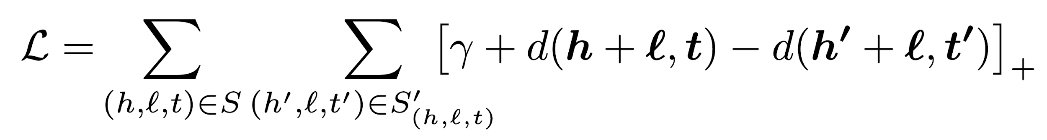
Task-Specific Baselines
Link Predictions
TransE, DistMult, KBGAN, ComplEx, … etc.
Node Classifications
Feat, WL, RDF2Vec, … etc.
Graph Classifications
Deep Graph CNN, Graph Isomorphism Network, … etc.
TransE Objective:
Notes:
For evaluating COMPGCN, we compare against several non-neural and neural baselines:

Slide 48
Goals of Experiments
Q1. CompGCN compared to existing methods on Link Predictions
Q2. Compare different GCN encoders and compositional operators
Q3. CompGCN scalability
Q4. CompGCN performance on node & graph classification
Notes:
Q1. How does COMPGCN perform on link prediction compared to existing methods? (6.1)
Q2. What is the effect of using different GCN encoders and choice of the compositional operator in COMPGCN on link prediction performance? (6.1)
Q3. Does COMPGCN scale with the number of relations in the graph? (6.3)
Q4. How does COMPGCN perform on node and graph classification tasks? (6.4)

Slide 49
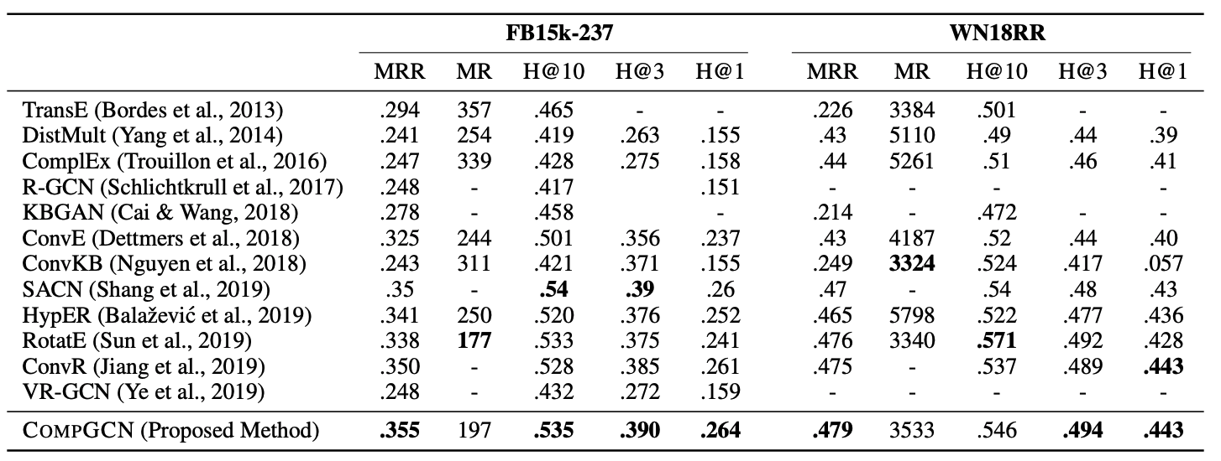
Results - Link Predictions
Notes:
Link prediction performance of COMPGCN and several recent models on FB15k-237 and WN18RR datasets.
The scores of baseline methods are taken directly from the previous papers.
We note that the best performing baseline RotatE uses rotation operation in complex domain. The same operation can be utilized in a complex variant of our proposed method to improve its performance further. We defer this as future work.

Slide 50
Results - Link Predictions
Notes:
Link prediction performance of COMPGCN and several recent models on FB15k-237 and WN18RR datasets.
The scores of baseline methods are taken directly from the previous papers.
We note that the best performing baseline RotatE uses rotation operation in complex domain. The same operation can be utilized in a complex variant of our proposed method to improve its performance further. We defer this as future work.

Slide 51
Results - Link Predictions
Notes:
Link prediction performance of COMPGCN and several recent models on FB15k-237 and WN18RR datasets.
The scores of baseline methods are taken directly from the previous papers.
We note that the best performing baseline RotatE uses rotation operation in complex domain. The same operation can be utilized in a complex variant of our proposed method to improve its performance further. We defer this as future work.

Slide 52
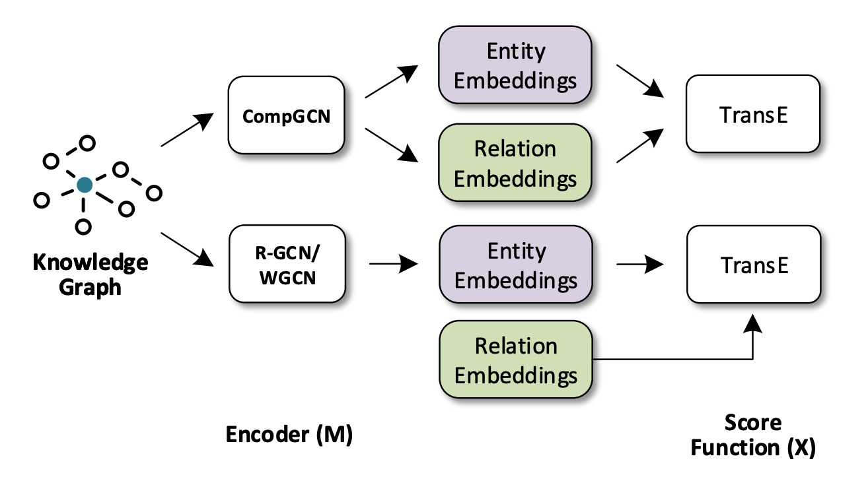
GCN Comparisons
Notes:
Knowledge Graph link prediction with COMPGCN and other methods. COMPGCN generates both entity and relation embedding as opposed to just entity embeddings for other models. For more details, please refer to Section 6.2.

Slide 53
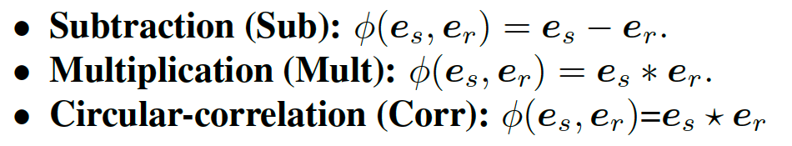
GCN Comparisons
Notes:
We evaluate COMPGCN on three non-parametric composition operators inspired from TransE (Bordes et al., 2013), DistMult (Yang et al., 2014), and HolE (Nickel et al., 2016) defined as shown here

Slide 54
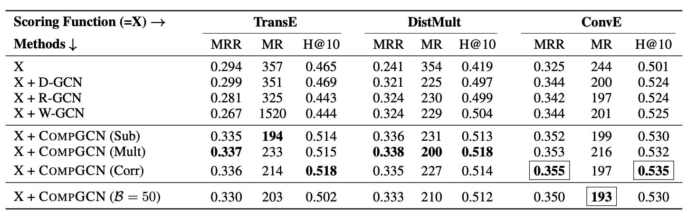
GCN Comparison Results - Link Predictions
X + M (Y): method M is used for obtaining entity/relation embeddings with X as scoring function. Y is the composition operator.
Notes:
Performance on link prediction task evaluated on FB15k-237 dataset. X + M (Y) denotes that method M is used for obtaining entity (and relation) embeddings with X as the scoring function. In the case of COMPGCN, Y denotes the composition operator used. B indicates the number of relational basis vectors used. Overall, we find that COMPGCN outperforms all the existing methods across different scoring functions. ConvE + COMPGCN (Corr) gives the best performance across all settings (highlighted using · ). Please refer to Section 6.1 for more details.

Slide 55
CompGCN Code Demo

Slide 56
Evaluating the Scalability
Effect of different number of basis vectors
Scaling up different number of relations
Compare to prior work R-GCN
Basis matrices instead of basis vectors

Slide 57
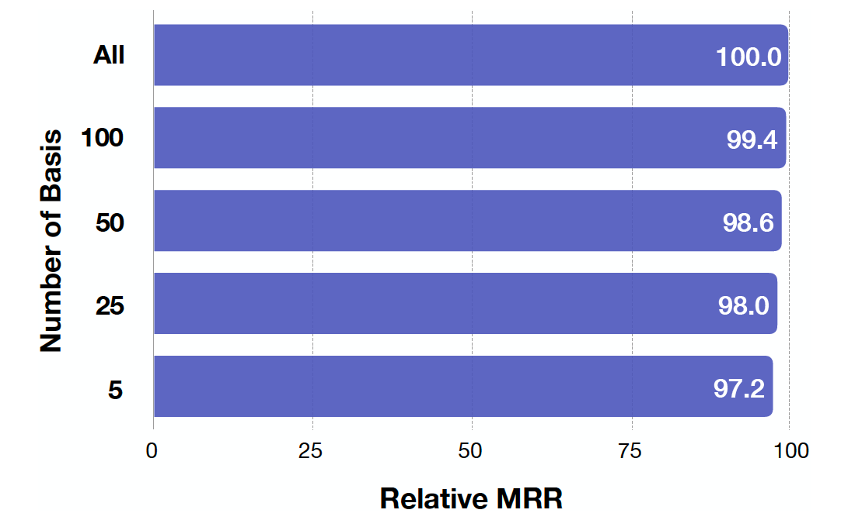
Number of Base Vectors
Notes:
Performance of COMPGCN with different number of relation basis vectors on link prediction task. We report the relative change in MRR on FB15k-237 dataset. Overall, COMPGCN gives comparable performance even with limited parameters.

Slide 58
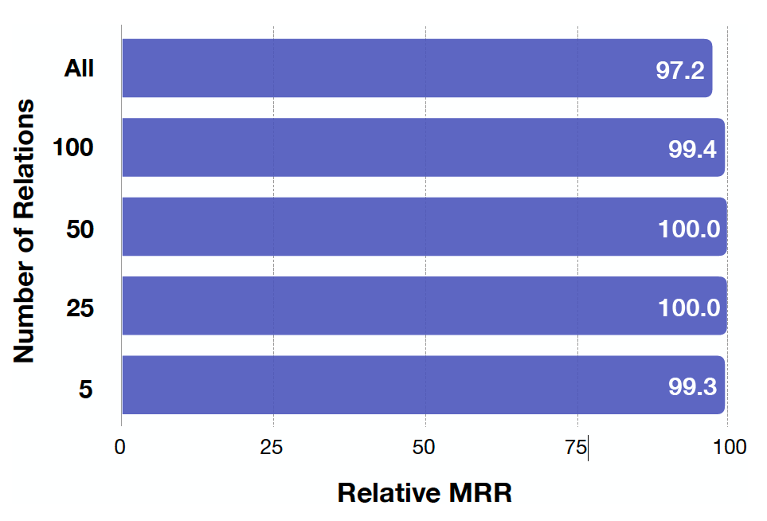
Number of Relations
Notes:
Performance of COMPGCN with different number of relations on link prediction task. We report the relative change in MRR on pruned versions of FB15k-237 dataset. Overall, COMPGCN gives comparable performance even with limited parameters.

Slide 59
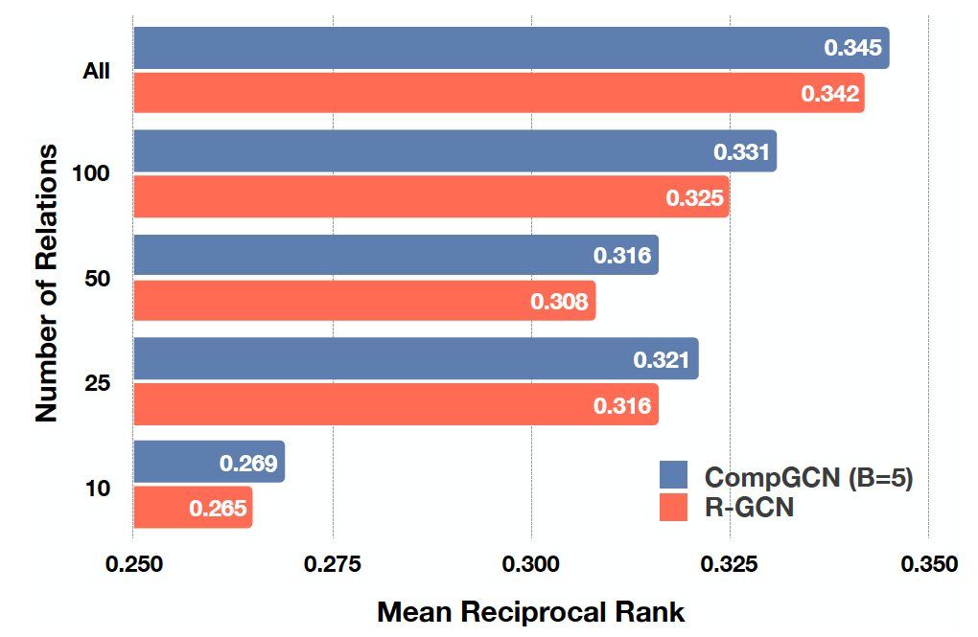
Compared to R-GCN
Notes:
Comparison of COMPGCN (B = 5) with R-GCN for pruned versions of Fb15k-237 dataset containing different number of relations. COMPGCN with 5 relation basis vectors outperforms R-GCN across all setups.

Slide 60
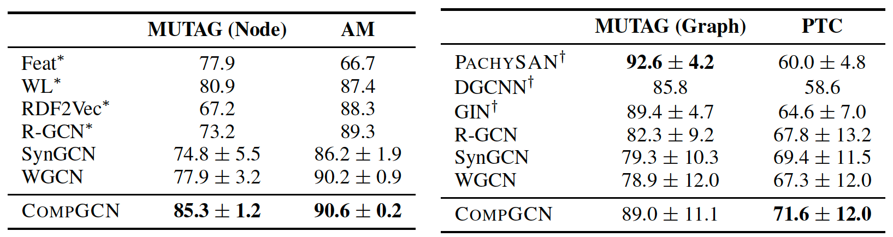
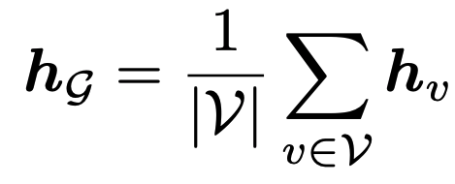
Node & Graph Classifications
Node Classification
Graph Classification
Read Out:
Notes:
Performance comparison on node classification (Left) and graph classification (Right) tasks. ∗ and † indicate that results are directly taken from Schlichtkrull et al. (2017) and Xu et al. (2019) respectively. Overall, we find that COMPGCN either outperforms or performs comparably compared to the existing methods.
we report the mean and standard deviation of validation accuracies across the 10 folds cross-validation. Crossentropy loss is used for training the entire model. For obtaining the graph-level representation, we use simple averaging of embedding of all nodes as the readout function, i.e.,

Slide 61
Outline
Introduction
Related Works
Background
Main Method: CompGCN
Experiments
Conclusions & Summaries

Slide 62
Summaries of CompGCN
Multi-Relational Knowledge Graphs
Representing Relations as Vectors
Compositional Operators
CompGCN Model
General
Alleviates over-parameterization
Scalable with basis vectors
Extensive Experiments
Notes:
we proposed COMPGCN, a novel Graph Convolutional based framework for multirelational graphs which leverages a variety of composition operators from Knowledge Graph embedding techniques to jointly embed nodes and relations in a graph. Our method generalizes several existing multi-relational GCN methods. Moreover, our method alleviates the problem of over-parameterization by sharing relation embeddings across layers and using basis decomposition.

Slide 63
CompGCN Future Works
More complex compositional operators
Learnable eg. ConvE
Superior compositional operations
Interpretable relational vectors

Slide 64
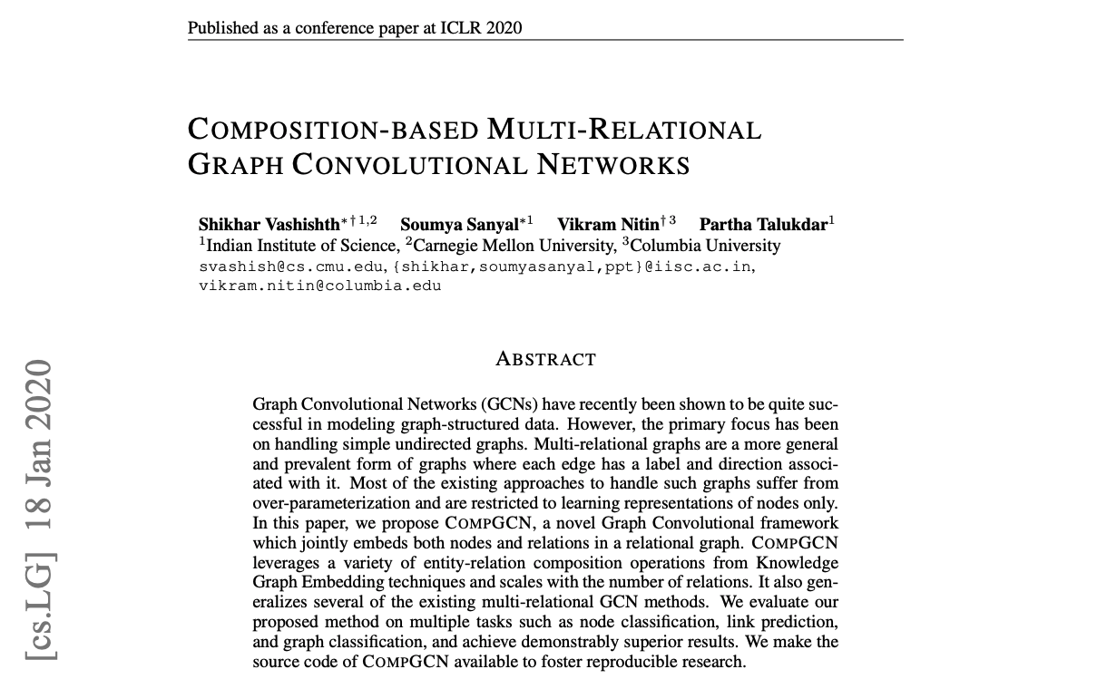
Paper: CompGCN at ICLR 2020

Slide 65
Thank You & QA

